Slide 1
Auto Insurance Company Data Analysis
Team Members
Ashutosh Dwivedi
Srija Gupta
Mohammed Rehan

Slide 2
Data
Dataset has sample of the claims data collected by auto-insurance provider, Indian Money, Bangalore, India
Collected by the organization during claims processing and reporting of claim data at the end of the year
Dataset has 15 variables and 7702 observations
Derived 4 variables: Zone, Vehicle Category, Revenue, Profit
Dependent Variable: Premium and Claim Amount
Independent variables: Age Group, IDV, Gender, Zone, Vehicle Category
Notes:
IDV - Insured Declared Value

Slide 3
Business/Research Question
What factors affect the profitability of Indian Money Insurance company?
Is there an impact of geography when it comes to the profitability of auto insurance?
Does Age Group or Gender affect the profitability of auto Insurance?

Slide 4
Hypothesis
The profitability of Indian Money is higher for female drivers in North zone.
The profitability of Indian Money is higher for drivers having age more than 40 years.
The profitability of Indian Money is higher for vehicles with cubic capacity more than 2200.

Slide 5
Variables Used For Analysis
Name | Data Type | Variable | Description
Year | Factor | CV | 7 Years of Data
IDV | Numeric | IV | Insured Declared value of Car
Gender | Factor | IV | Male or Female
Zone | Factor | IV | Divided Regions of the Country
Age Group | Factor | IV | Age groups of Applicants
ClaimsInd | Factor | IV | Claims Take(0-not taken,1-Taken)
Vehicle Category | Factor | IV | Clubbed to Cubic Capacity size
Revenue | Numeric | DV | Derived from Premium minus Claim
Profit | Numeric | DV | Profitability - Derived column(Revenue %)
Notes:
Profitability - Revenue / Max(Revenue) * 100

Slide 6
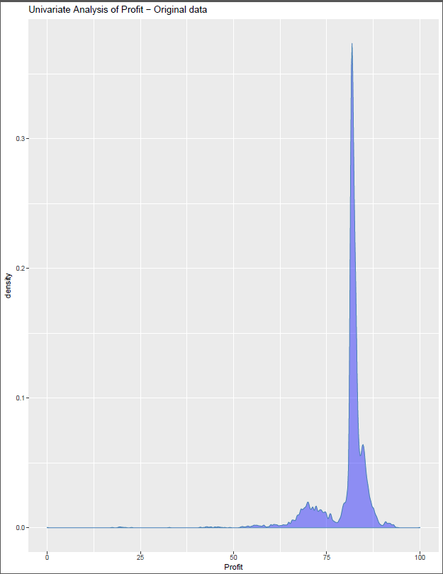
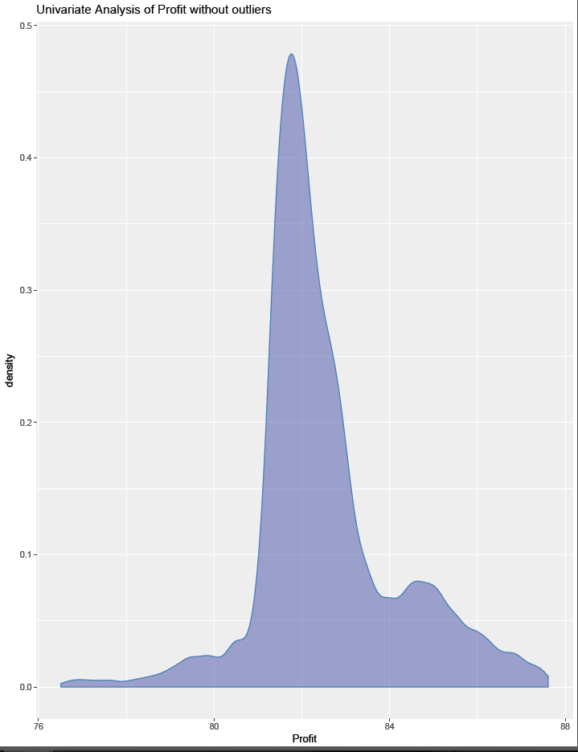
Profit Univariate Analysis
Original Data- With Outliers
Without Outliers

Slide 7
Relevant Analysis
Profit with IDV
Profit with Gender
Profit with Zone
Profit with Age Group
Profit with Vehicle Category
Linear Model

Slide 8
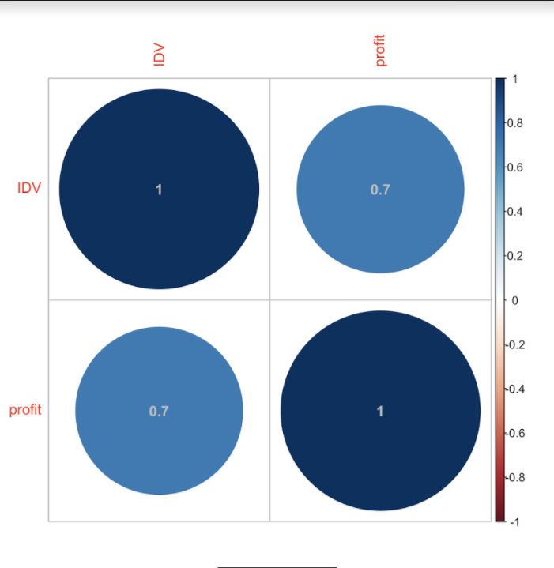
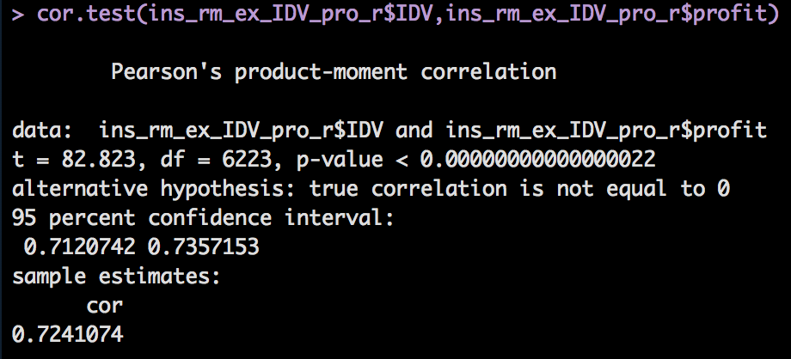
Profit with IDV
Profit has a strong correlation with IDV

Slide 9
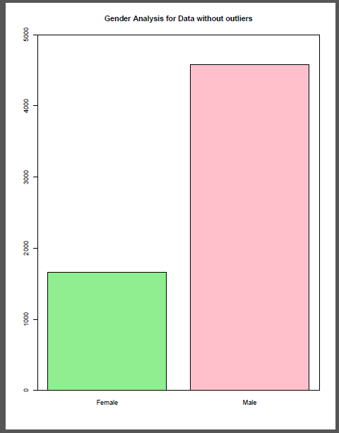
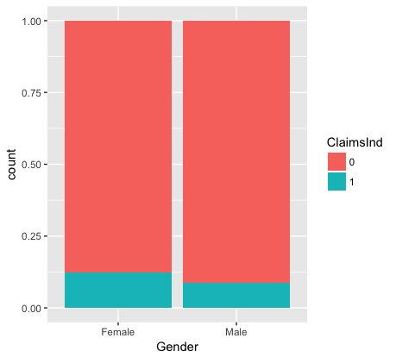
Analysis - Gender
Our Hypothesis - Profit more for Female as to Male

Slide 10
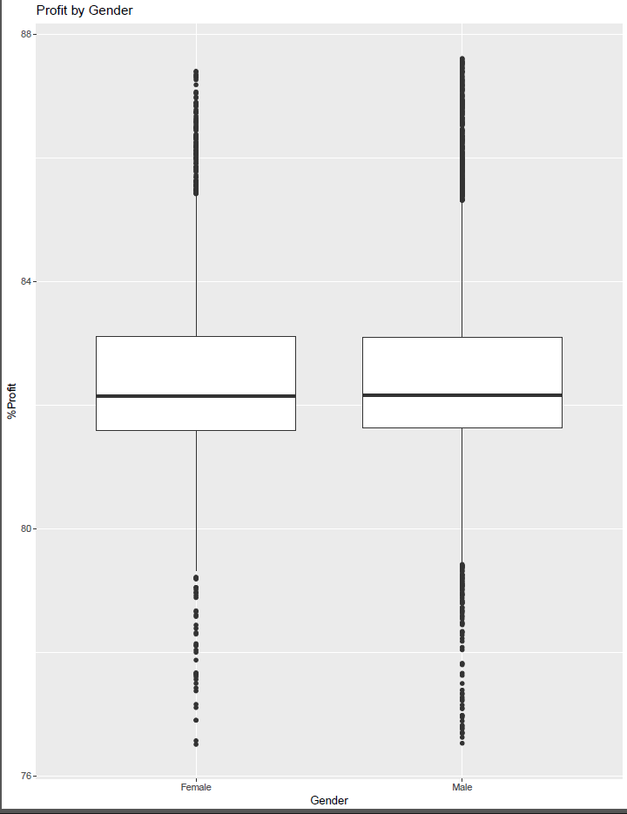
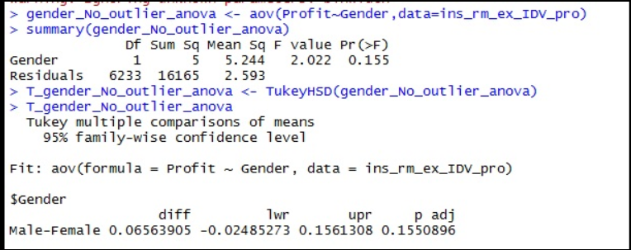
Profit with Gender
Conclusion - We fail to reject Null Hypothesis and thus there is no relationship of Profit by Gender

Slide 11
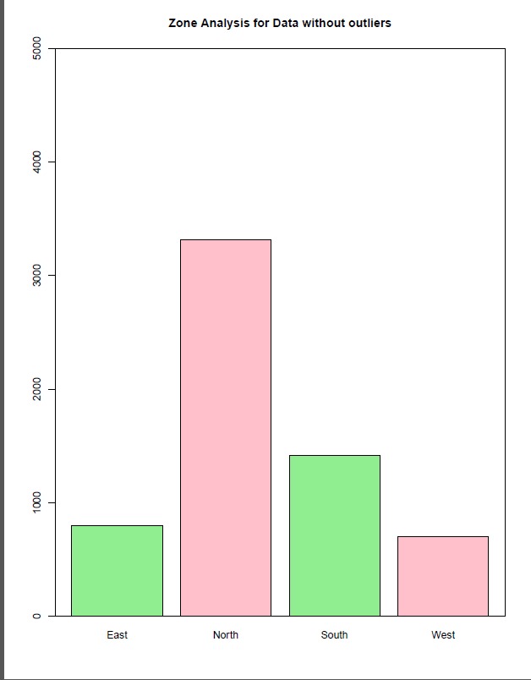
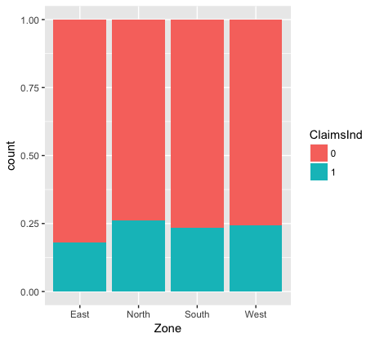
Analysis - Zone
Our Hypothesis - Profit more for North Zone as to other zones

Slide 12
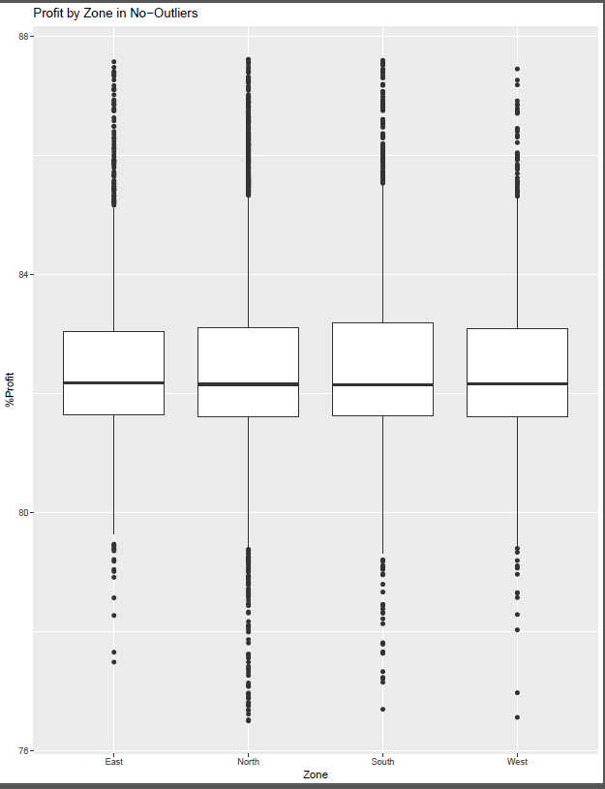
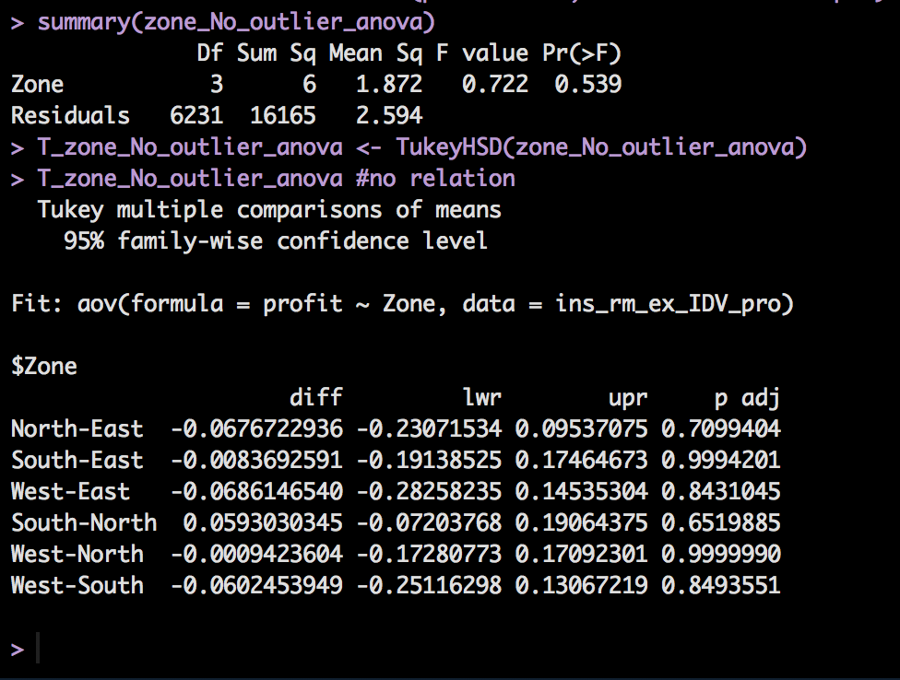
Profit with Zone
Conclusion - We fail to reject Null Hypothesis and thus there is no relationship of Profit by Zone

Slide 13
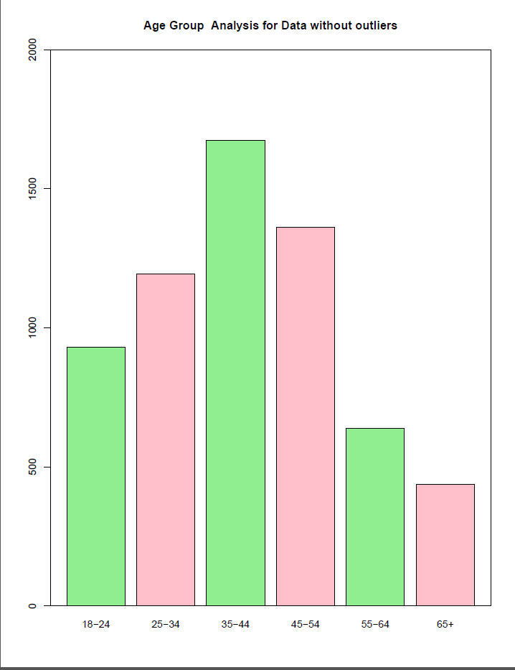
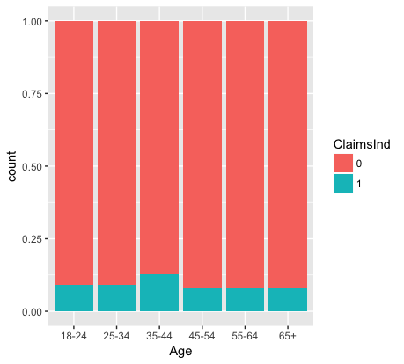
Analysis - Age Group
Our Hypothesis - Profit more for Age Group over 40 years than rest

Slide 14
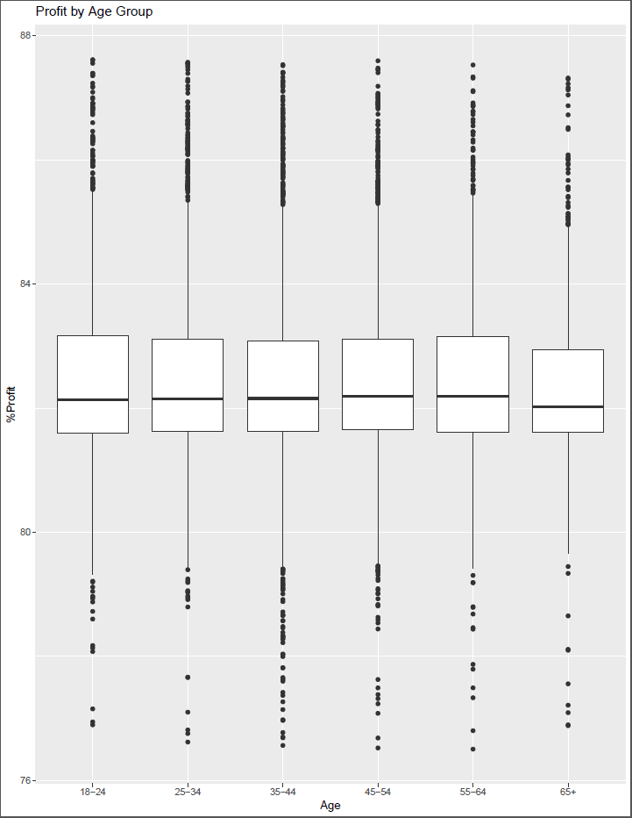
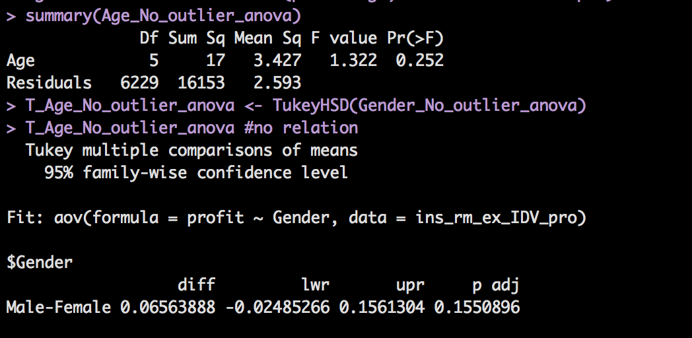
Profit with Age Group
Conclusion - We fail to reject Null Hypothesis and thus there is no relationship of Profit by Age Group

Slide 15
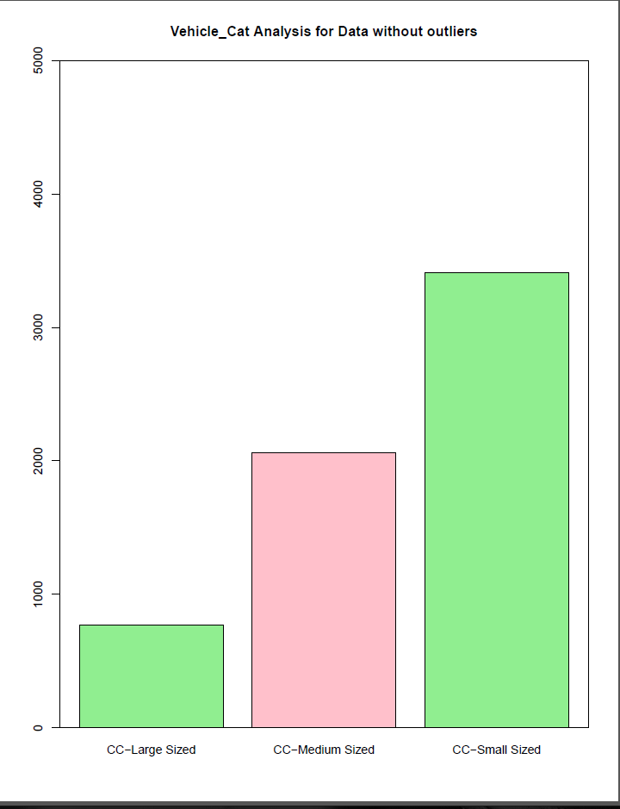
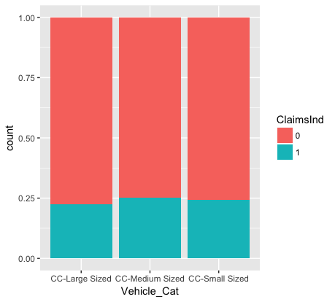
Analysis - Vehicle Category
Our Hypothesis - Profit more for Large Size CC vehicles that rest of categories

Slide 16
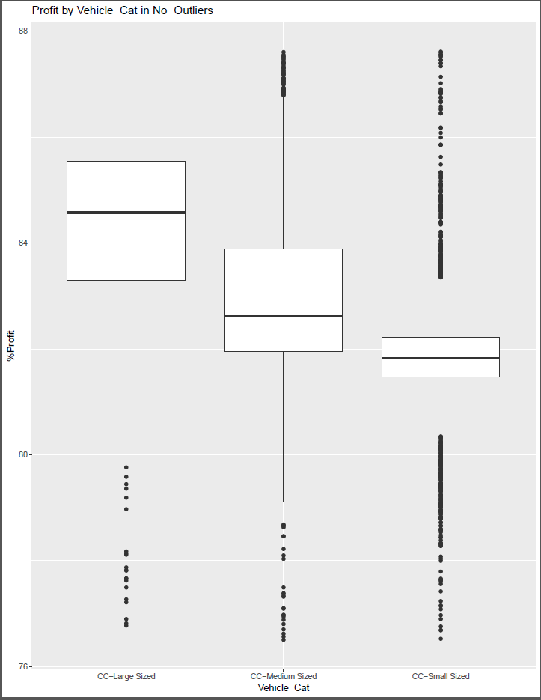
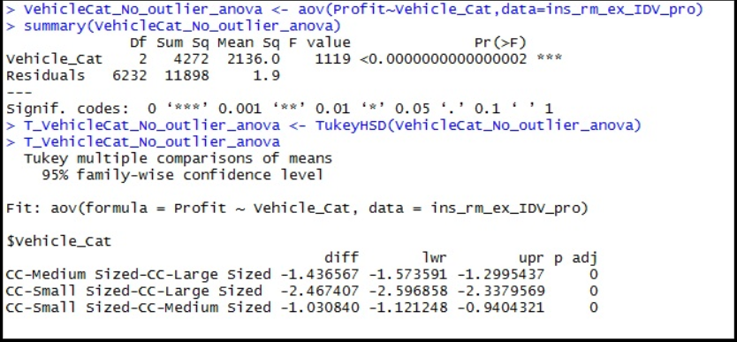
Profit with Vehicle Category
Conclusion - We are successful to reject the Null Hypothesis.
Profit increase as the CC size of Vehicle increases.

Slide 17
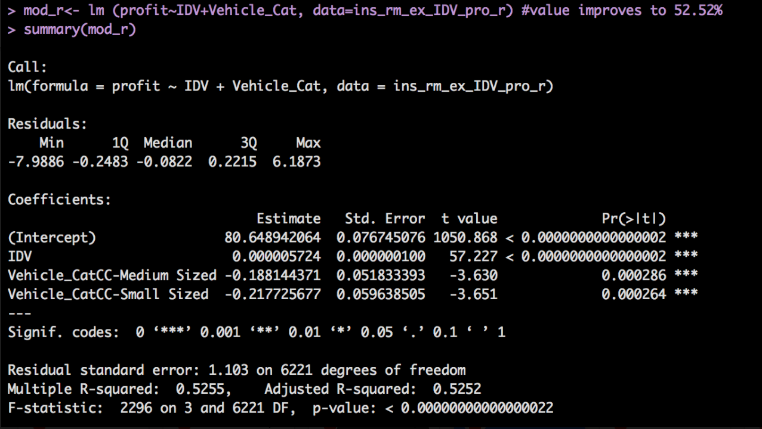
Linear Model - Profit by IDV + Vehicle Category

Slide 18
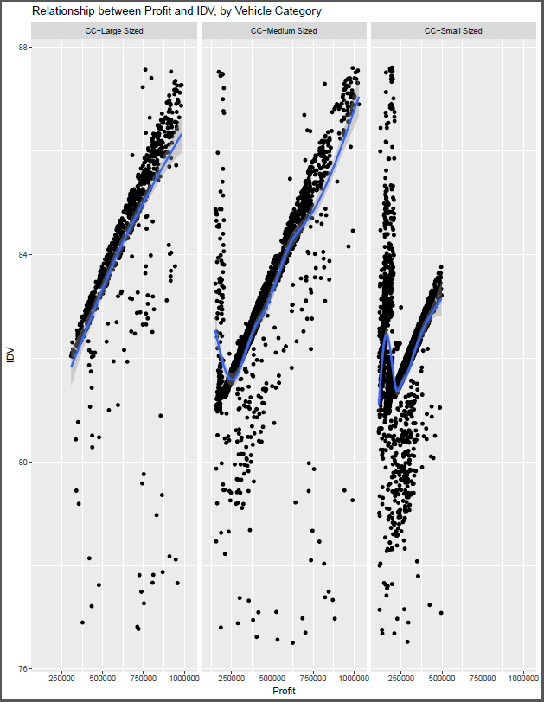
Linear Model - Profit by IDV + Vehicle Category ...

Slide 19
Conclusion
As per our analysis based on the available dataset,
Profit is not dependent on age & gender of the driver.
Profit is not dependent on any geographical zone.
Profit of the company increases with the increase in cubic capacity of the vehicle.
“Company should focus on insuring vehicles with higher cubic capacity”.
*Limitations: There are many other factors like experience of driver, driver’s state of mind and severity of accident which may further affect the profitability and affect the models (r-square) value.

Slide 20
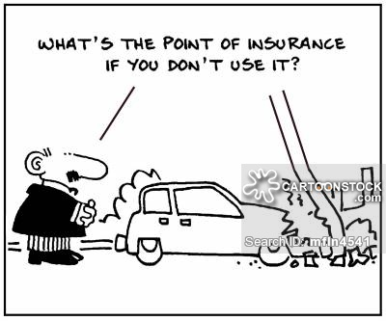
Questions ?
or
Suggestions.

